Slide 1
C2 Improvements Jatin Bhateja

Slide 2
Agenda
Cost of allocation
Brief overview of Escape Analysis
Brief overview of Partial Escape analysis
Value proposition of Value Types and C2 compiler handling.
Performance comparison of C2 EA vs Graal PAE vs Valhalla.
Next Steps

Slide 3
Cost of allocation
In Java, each class instance or an array is allocated on the heap.
Each object has a lock associated with it, which is used to ensure mutual exclusion when a synchronized method or statement is invoked on the object.
Both heap allocation and synchronization on locks incur performance
overhead.
High object allocation rate with small heap can result into frequent GC cycles which significantly impacts application throughput.

Slide 4
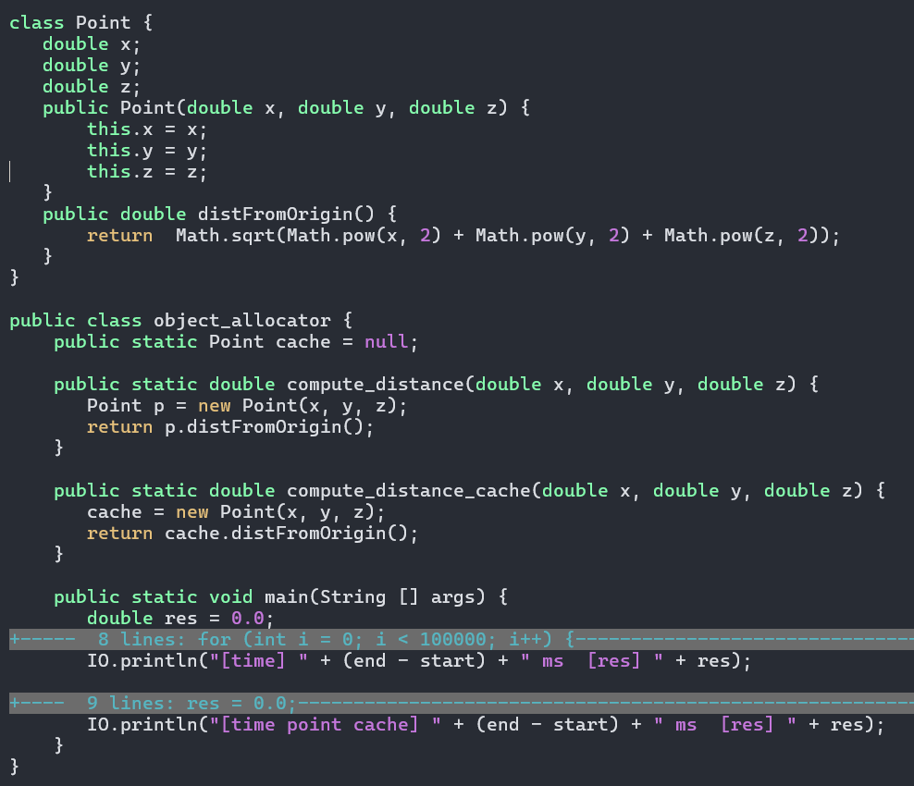

Example

Slide 5
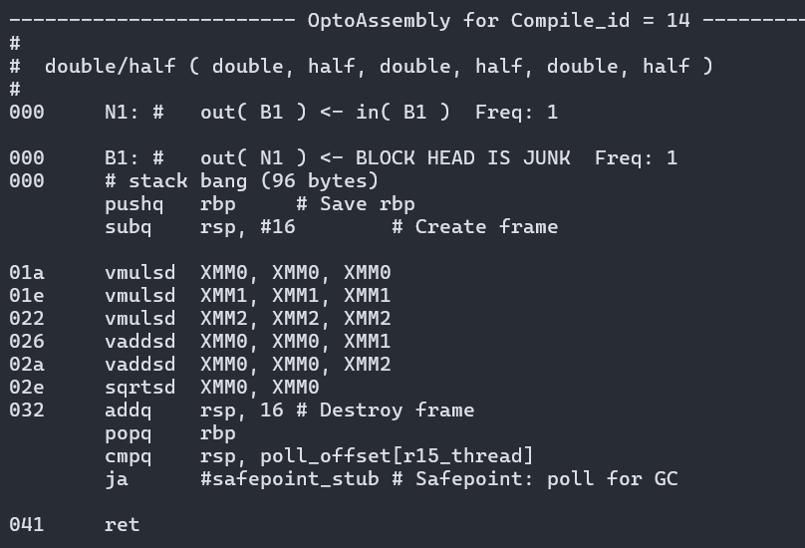
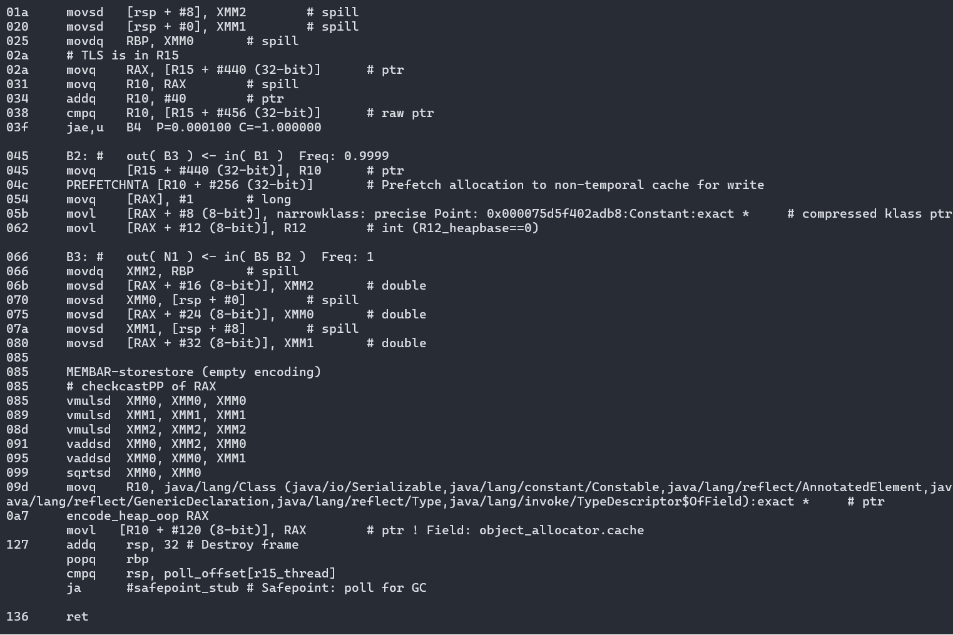

Slide 6
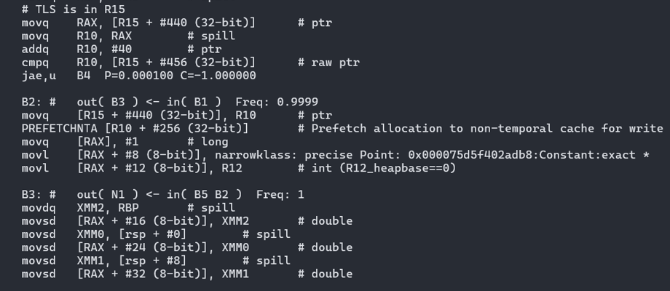
Unpack allocation JIT sequence
Sequence involves
1 TLS LOAD
1 TLS STORE
1 CISC compare
Several field initialization STOREs.
PREFETCH – hint to load subsequent cache lines for faster access.
Cost of memory operations
Load / store needs at least 4 cycles (L1D access latency)

Slide 7
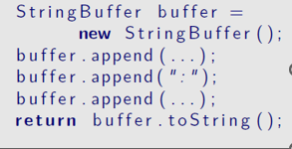
Cost of using frameworks
Frameworks such as Java EE and languages such as Scala, confront Java VMs with additional levels of abstractions, which usually consist of small and short-lived objects.
Other Microservices frameworks like Spring Boot, Micronaut generates lots of boiler plate code creating short lived objects which impacts application startup.
Aggressive Inlining coupled with Escape Analysis can help in removing these abstractions. Java itself also introduces additional layers of abstraction, such as in the following examples
StringBuffer in the above example is a synchronized data structure, so that every operation needs to acquire the object’s lock. However, it is obvious that the buffer object does not escape and lock will never be contented.

Slide 8
Escape Analysis
Efficient data flow algorithm which determines whether an allocation
may escape the method (i.e., is not local to the method) that created the object.
may escape the thread that created the object.
If an allocation is non-escaping.
It can be allocated on the method’s stack frame.
Stack allocation is inherently cheaper than heap allocation, we just saw the cost associated with each allocation.
Stack allocation also reduces garbage collection overhead.
If object does not escape a method, it opens up the possibility of strength reducing the object accesses (SROA : scalar replacements of aggregate)

Slide 9
If an allocation does not escape a thread
No other thread can access the object.
we can eliminate the synchronization associated with this object
Java memory model requires that we flush the Java local memory at monitorenter and monitorexit bytecodes.

Slide 10
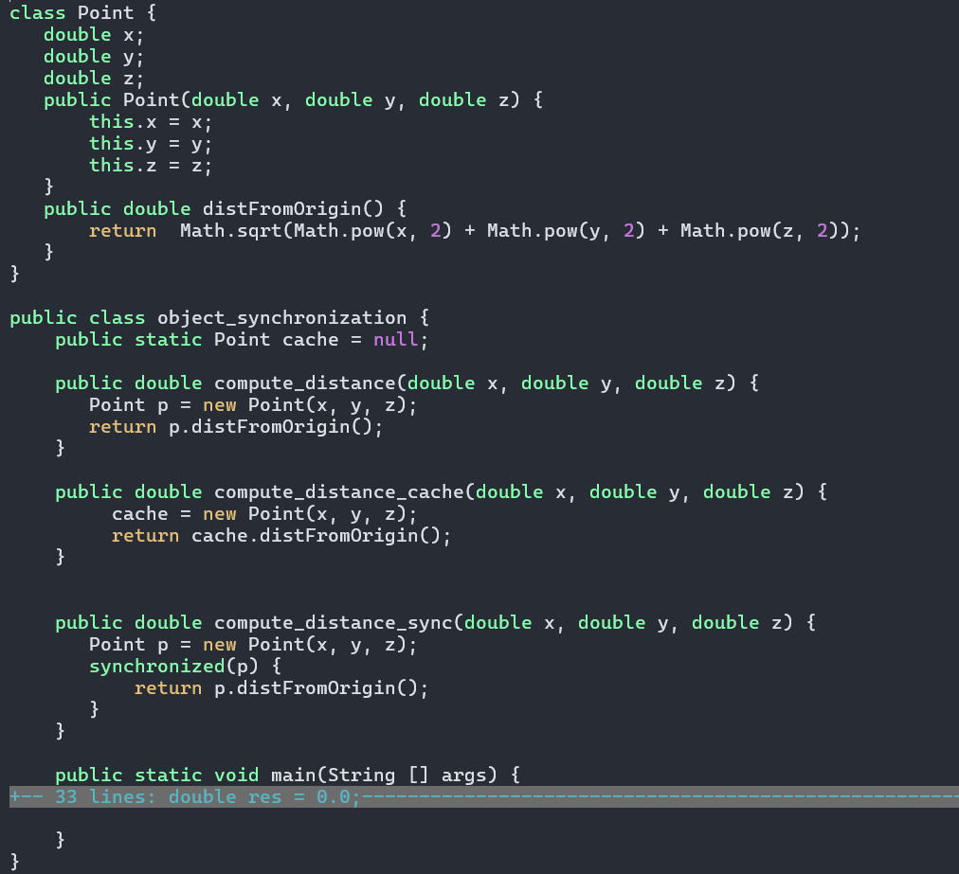
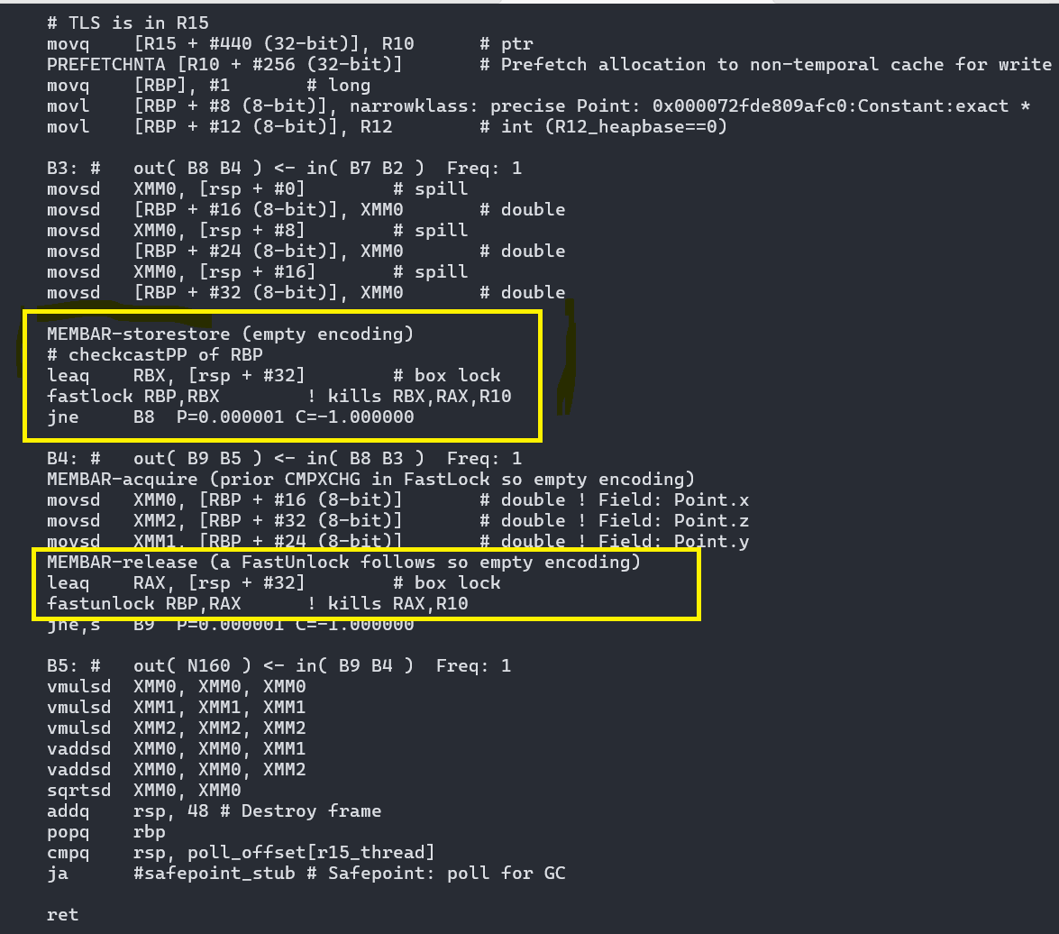
Example

Slide 11
Escape analysis …
Framework for escape analysis is based on a simple program abstraction called the connection graph.
The connection graph abstraction captures the “connectivity” relationship among heap allocated objects and object references.
We simply perform reachability analysis on the connection graph to determine if an object is local to a method or local to a thread.
We define an escapement lattice consisting of three elements: NoEscape , ArgEscape, and GlobalEscape .
ArgEscape : Object escape the method though argument but does not escape the thread. Phantom object representing the actual argument to method.
GlobalEscape : Object is regarded as escaping globally i.e. all threads and methods. E.g. static fields of a class and Rum-table
No Escape : Object does not escape the method in which it was created. Objects which are not ArgEscape or GlobalEscape objects.
Upon the completion of our intraprocedural analysis, all objects that are marked NoEscape are stack-allocatable in the method in which they are created.
NoEscape orArgEscupe, are local to the thread.
We can eliminate the synchronization in accessing these objects without violating Java semantics

Slide 12
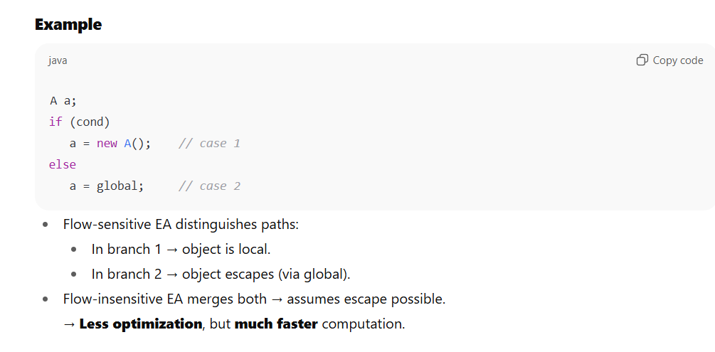
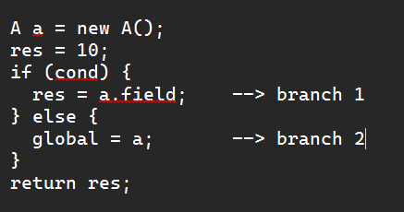

Flow Sensitive vs Flow In-sensitive EA
What Flow Sensitivity Means
Definition
A flow-sensitive escape analysis respects the order of execution of statements inside a method. In other words, it models how object references change as control flows through the program
Flow-Insensitive Escape Analysis
Definition
Flow-insensitive EA ignores control flow ordering — it assumes all program statements execute in an arbitrary order.

Slide 13
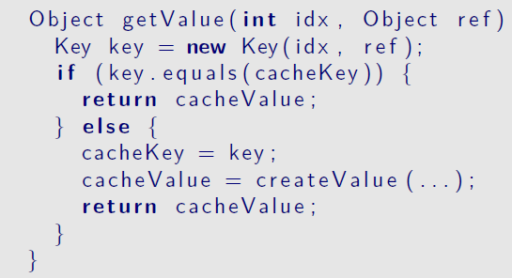
Partial Escape Analysis
In many cases, making a global decision about the escapability of objects does not allow the compiler to perform optimizations, because most objects escape at least in some branches.

Slide 14
In the previous example, the newly allocated object escapes in false path while it remains as non-escaping if we take the true path.
Partial escape analysis iterates over the control flow graph and maintains the current escape state and the current contents of allocated objects during this process.
Initially, each allocated object is in the state virtual, which means that there was no reason yet to actually allocate it. As the algorithm progresses along the control flow, it updates this state when instructions operate on the allocated object.

Slide 15
Analogy with Valhalla Value Types
Partial escape analysis initially assign all the newly allocated object a virtual state and defer the actual allocation decision to the point where the object escapes.
Valhalla introduced the notion of value types, an instance of a value type is identity free, i.e. unlike identity instance which has a unique representation in heap, which is used to differentiate it from other identity instances, two iso-morphic value instance are non-differentiable.
C2 compiler create a scalarized IR (InlineTypeNode) for each value object when it exits the larval state.
A value is only materialized if there is a non-scalarized use for it, e.g. assignment to a non-flat field or static fields (part of class mirror and shared by all the instances).

Slide 16
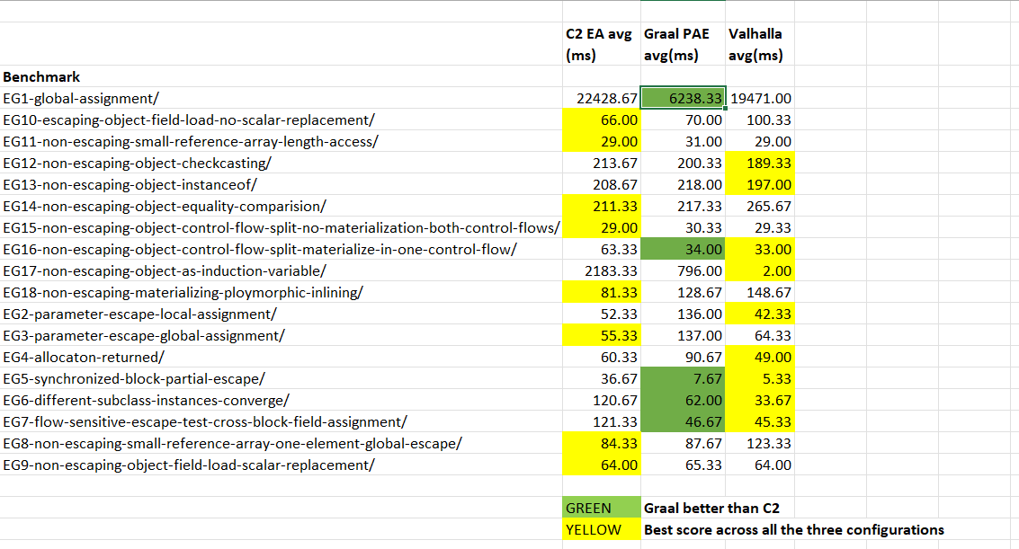
Performance comparison of C2 EA vs Graal PAE vs Valhalla
Compared performance multiple micro benchmarks with following 3 configurations.
C2 EA
Graal PAE
Valhalla
https://github.com/jatin-bhateja/external_staging/tree/main/Valhalla/partial_escape_analysis_graal_c2_valhalla/JDK-8366137

Slide 17
Next steps
Deep dive in to JIT code and root cause the performance gaps b/w C2 and Graal.
Study the findings of earlier attempt to implement PAE in C2
https://mail.openjdk.org/pipermail/hotspot-compiler-dev/2023-January/062018.html
https://mail.openjdk.org/pipermail/hotspot-compiler-dev/2023-March/063118.html
https://mail.openjdk.org/pipermail/hotspot-compiler-dev/2023-May/065068.html
https://mail.openjdk.org/pipermail/hotspot-compiler-dev/2023-July/066670.html
https://mail.openjdk.org/pipermail/hotspot-compiler-dev/2023-August/067286.html
References
Escape analysis for Java
https://dl.acm.org/doi/10.1145/320385.320386
Partial Escape Analysis and Scalar Replacement for Java
https://ssw.jku.at/Teaching/PhDTheses/Stadler/Thesis_Stadler_14.pdf

